Slide 1
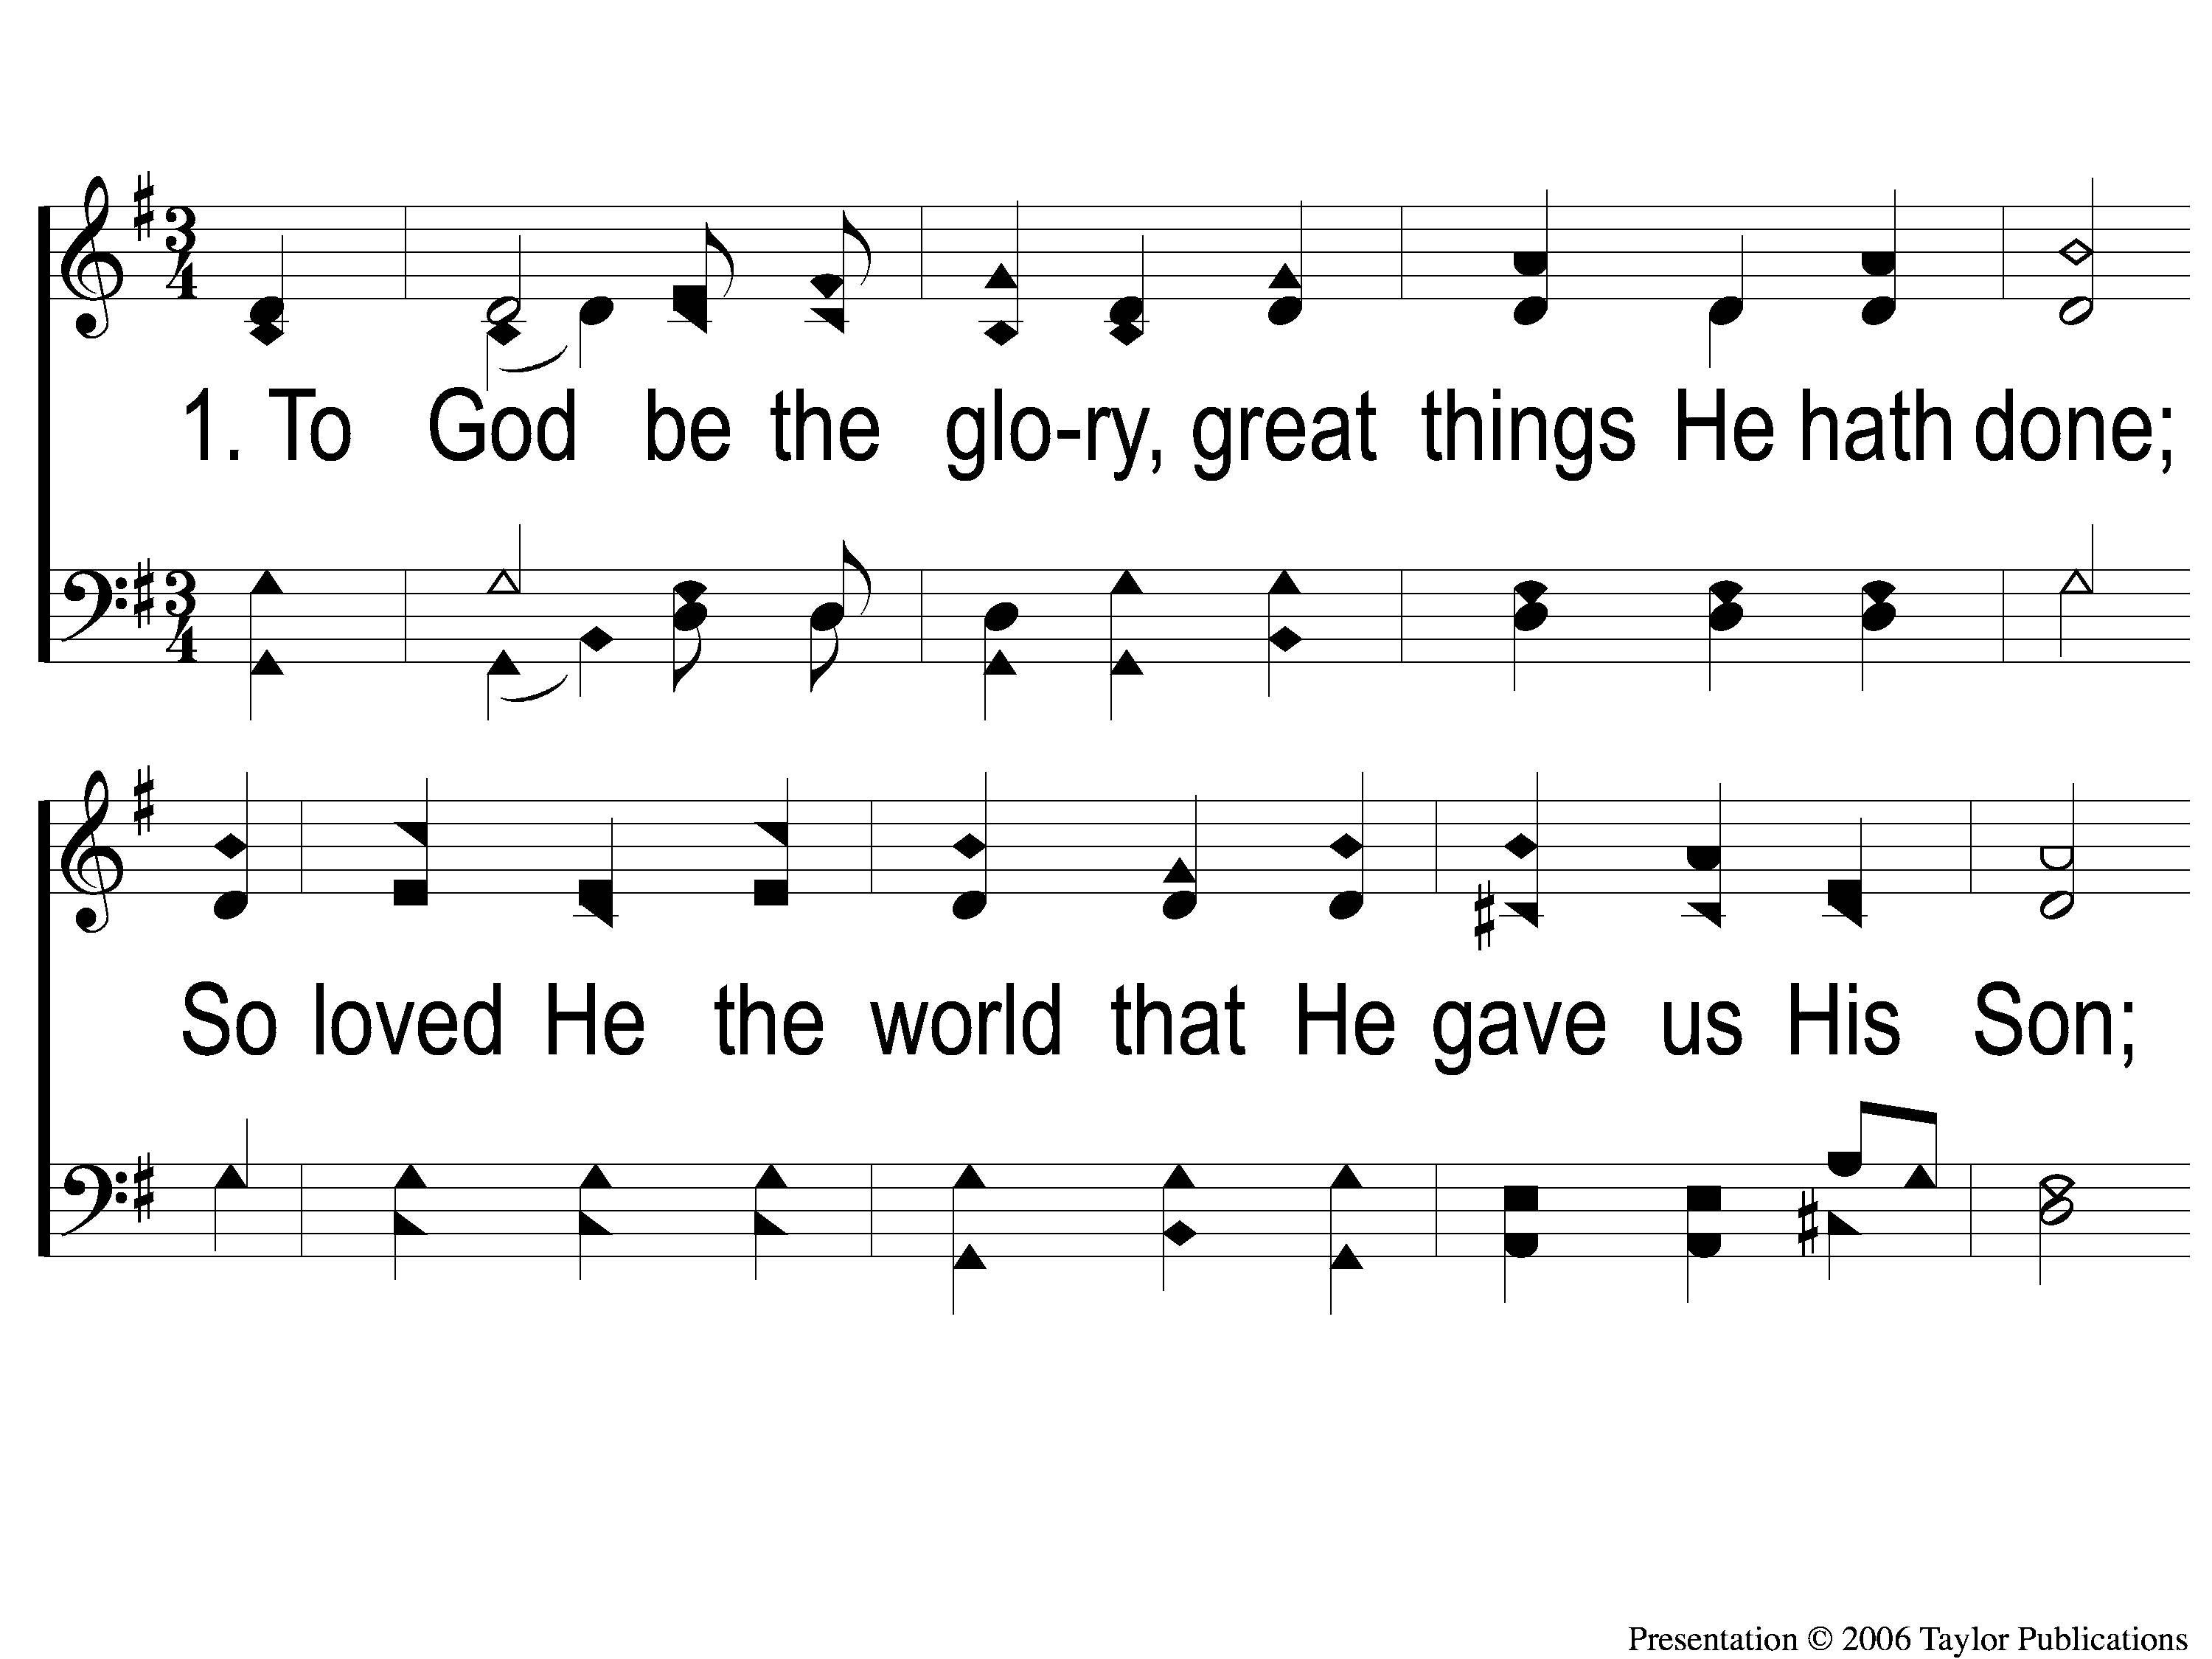
1-1 To God Be the Glory
To God Be the Glory
15

Slide 2
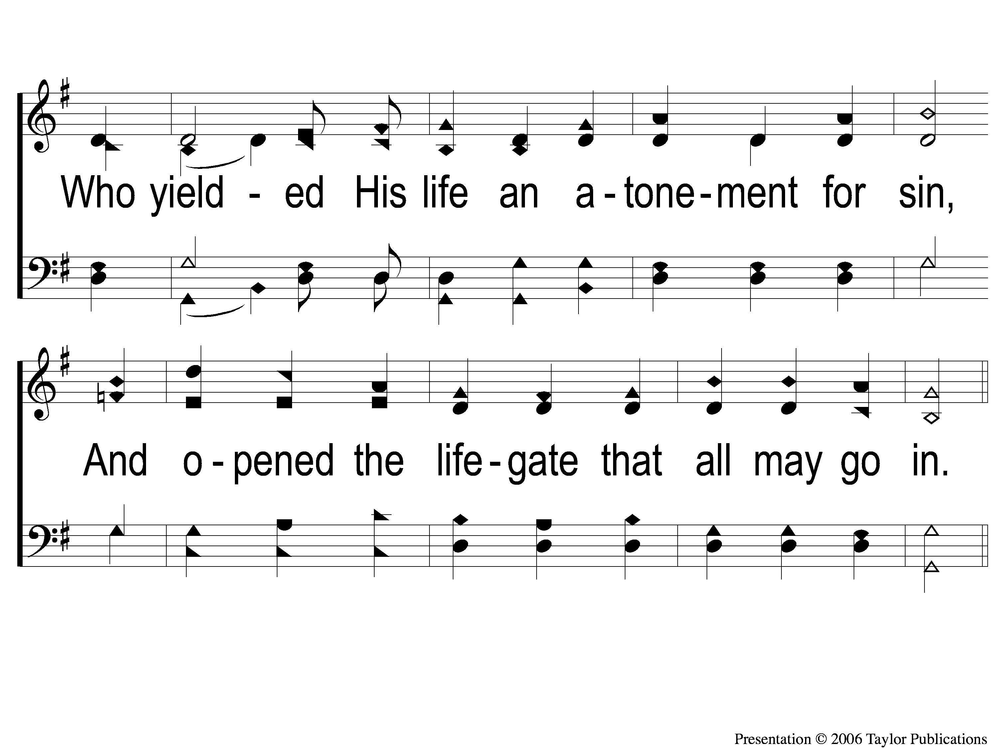
1-2 To God Be the Glory
To God Be the Glory
15

Slide 3
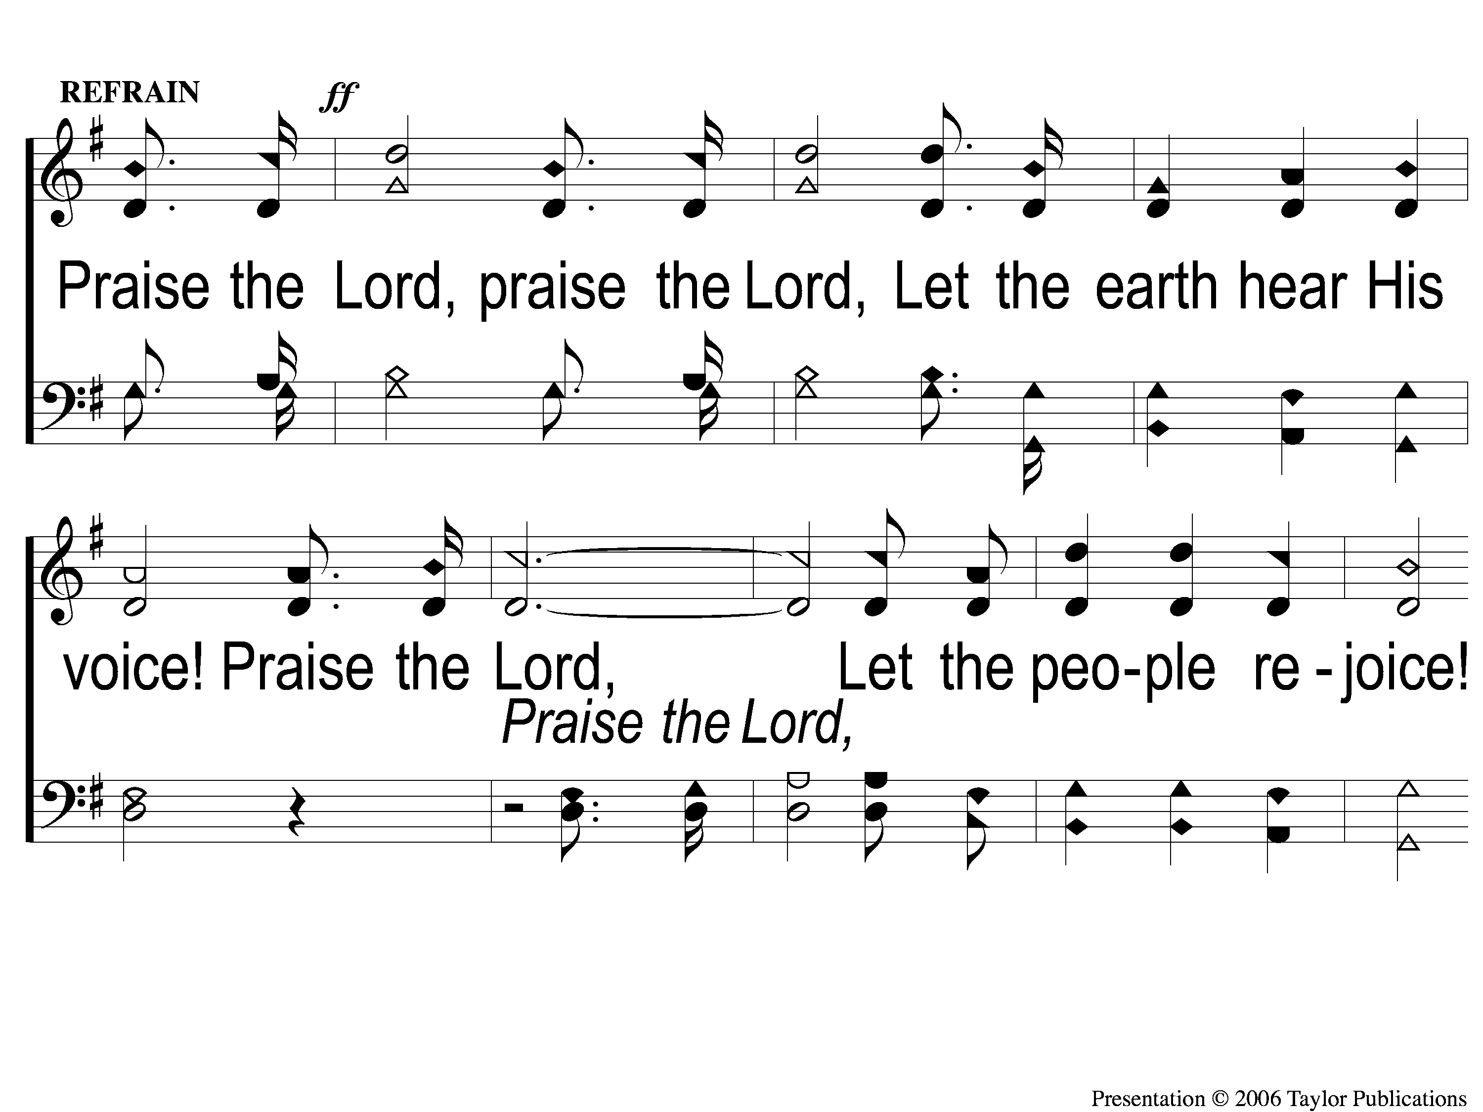
C-1 To God Be the Glory
To God Be the Glory
15

Slide 4
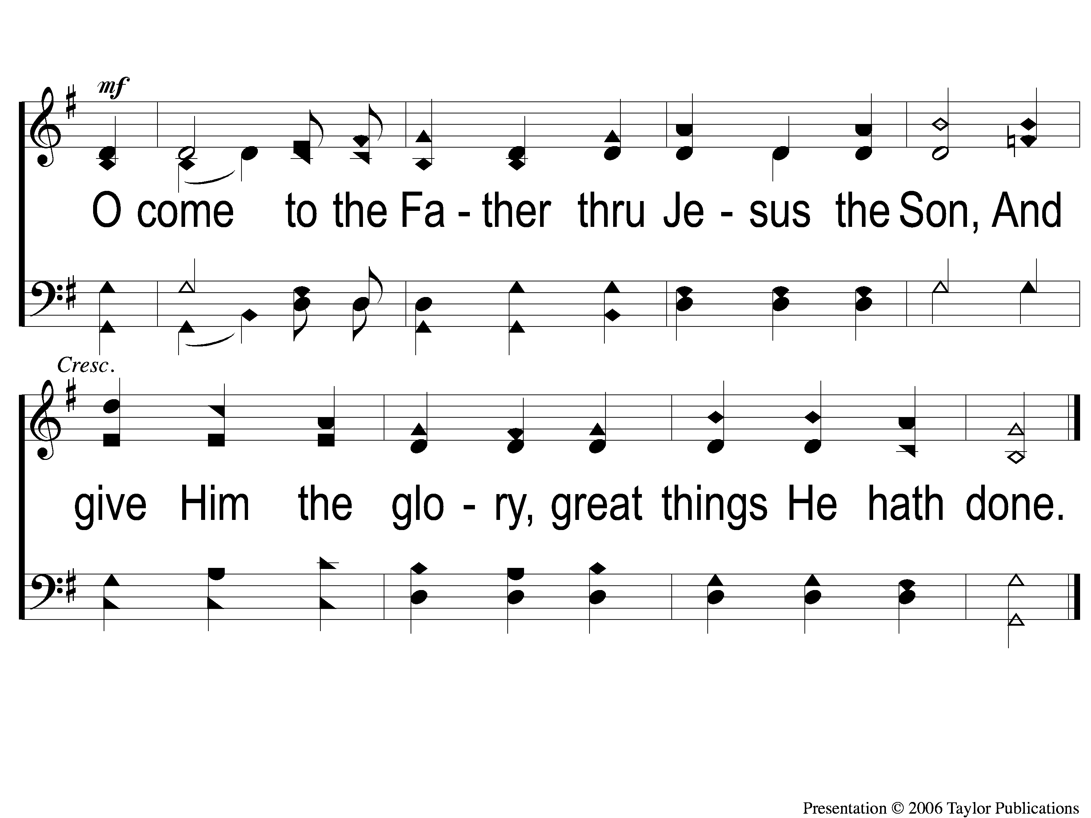
C-2 To God Be the Glory
To God Be the Glory
15

Slide 5
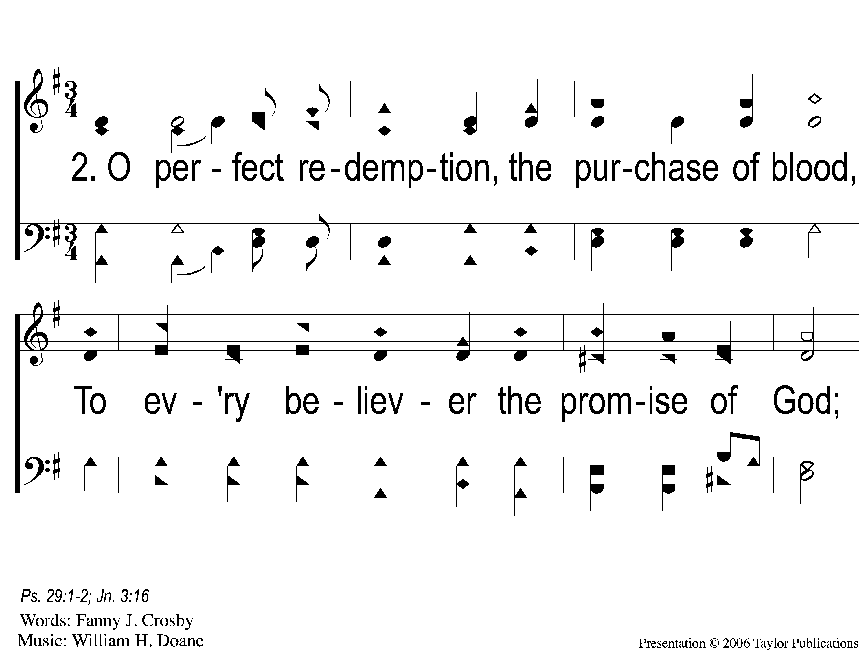
2-1 To God Be the Glory
To God Be the Glory
15

Slide 6
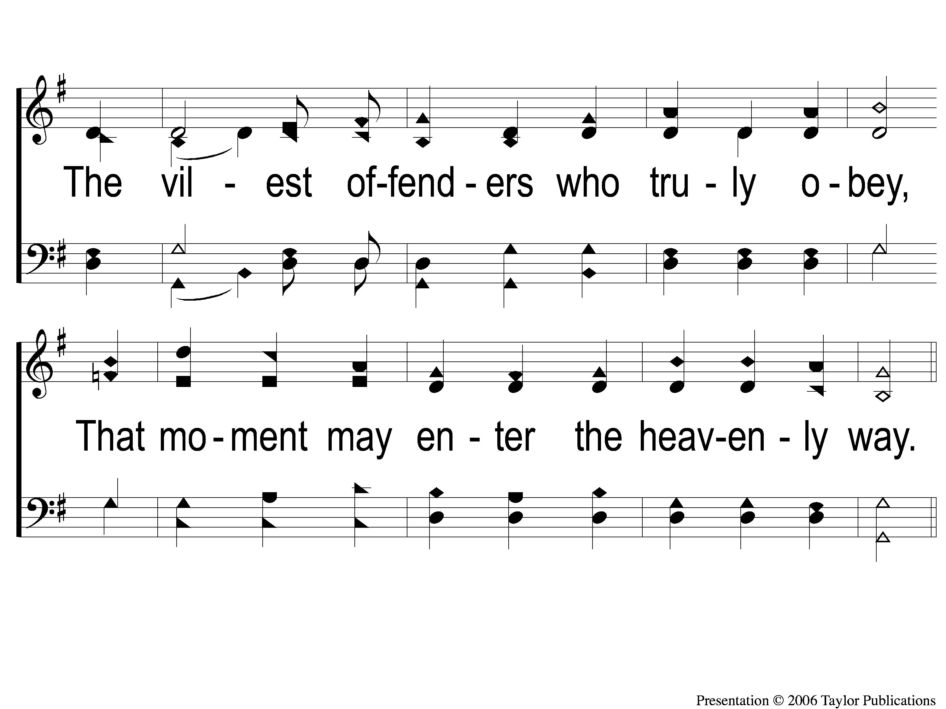
2-2 To God Be the Glory
To God Be the Glory
15

Slide 7
C-1 To God Be the Glory
To God Be the Glory
15

Slide 8
C-2 To God Be the Glory
To God Be the Glory
15

Slide 9
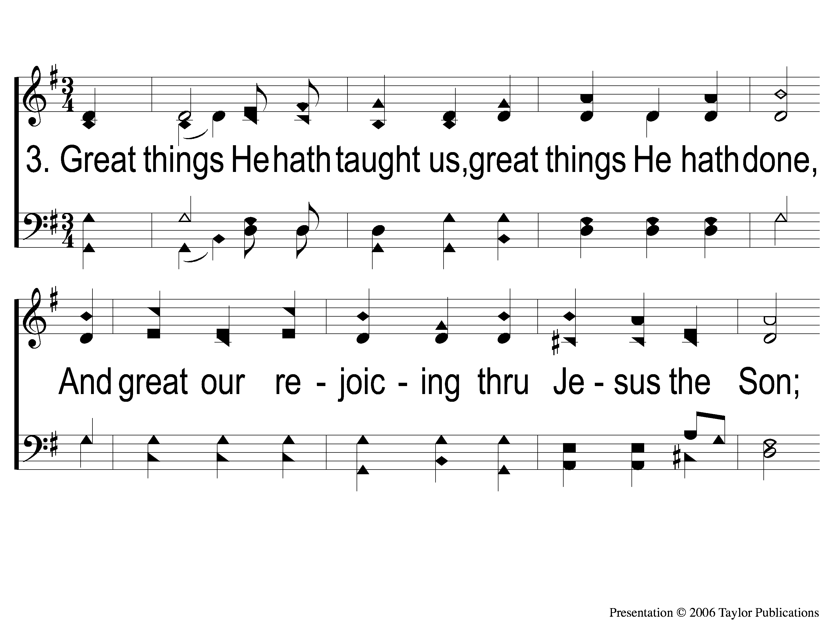
3-1 To God Be the Glory
To God Be the Glory
15

Slide 10
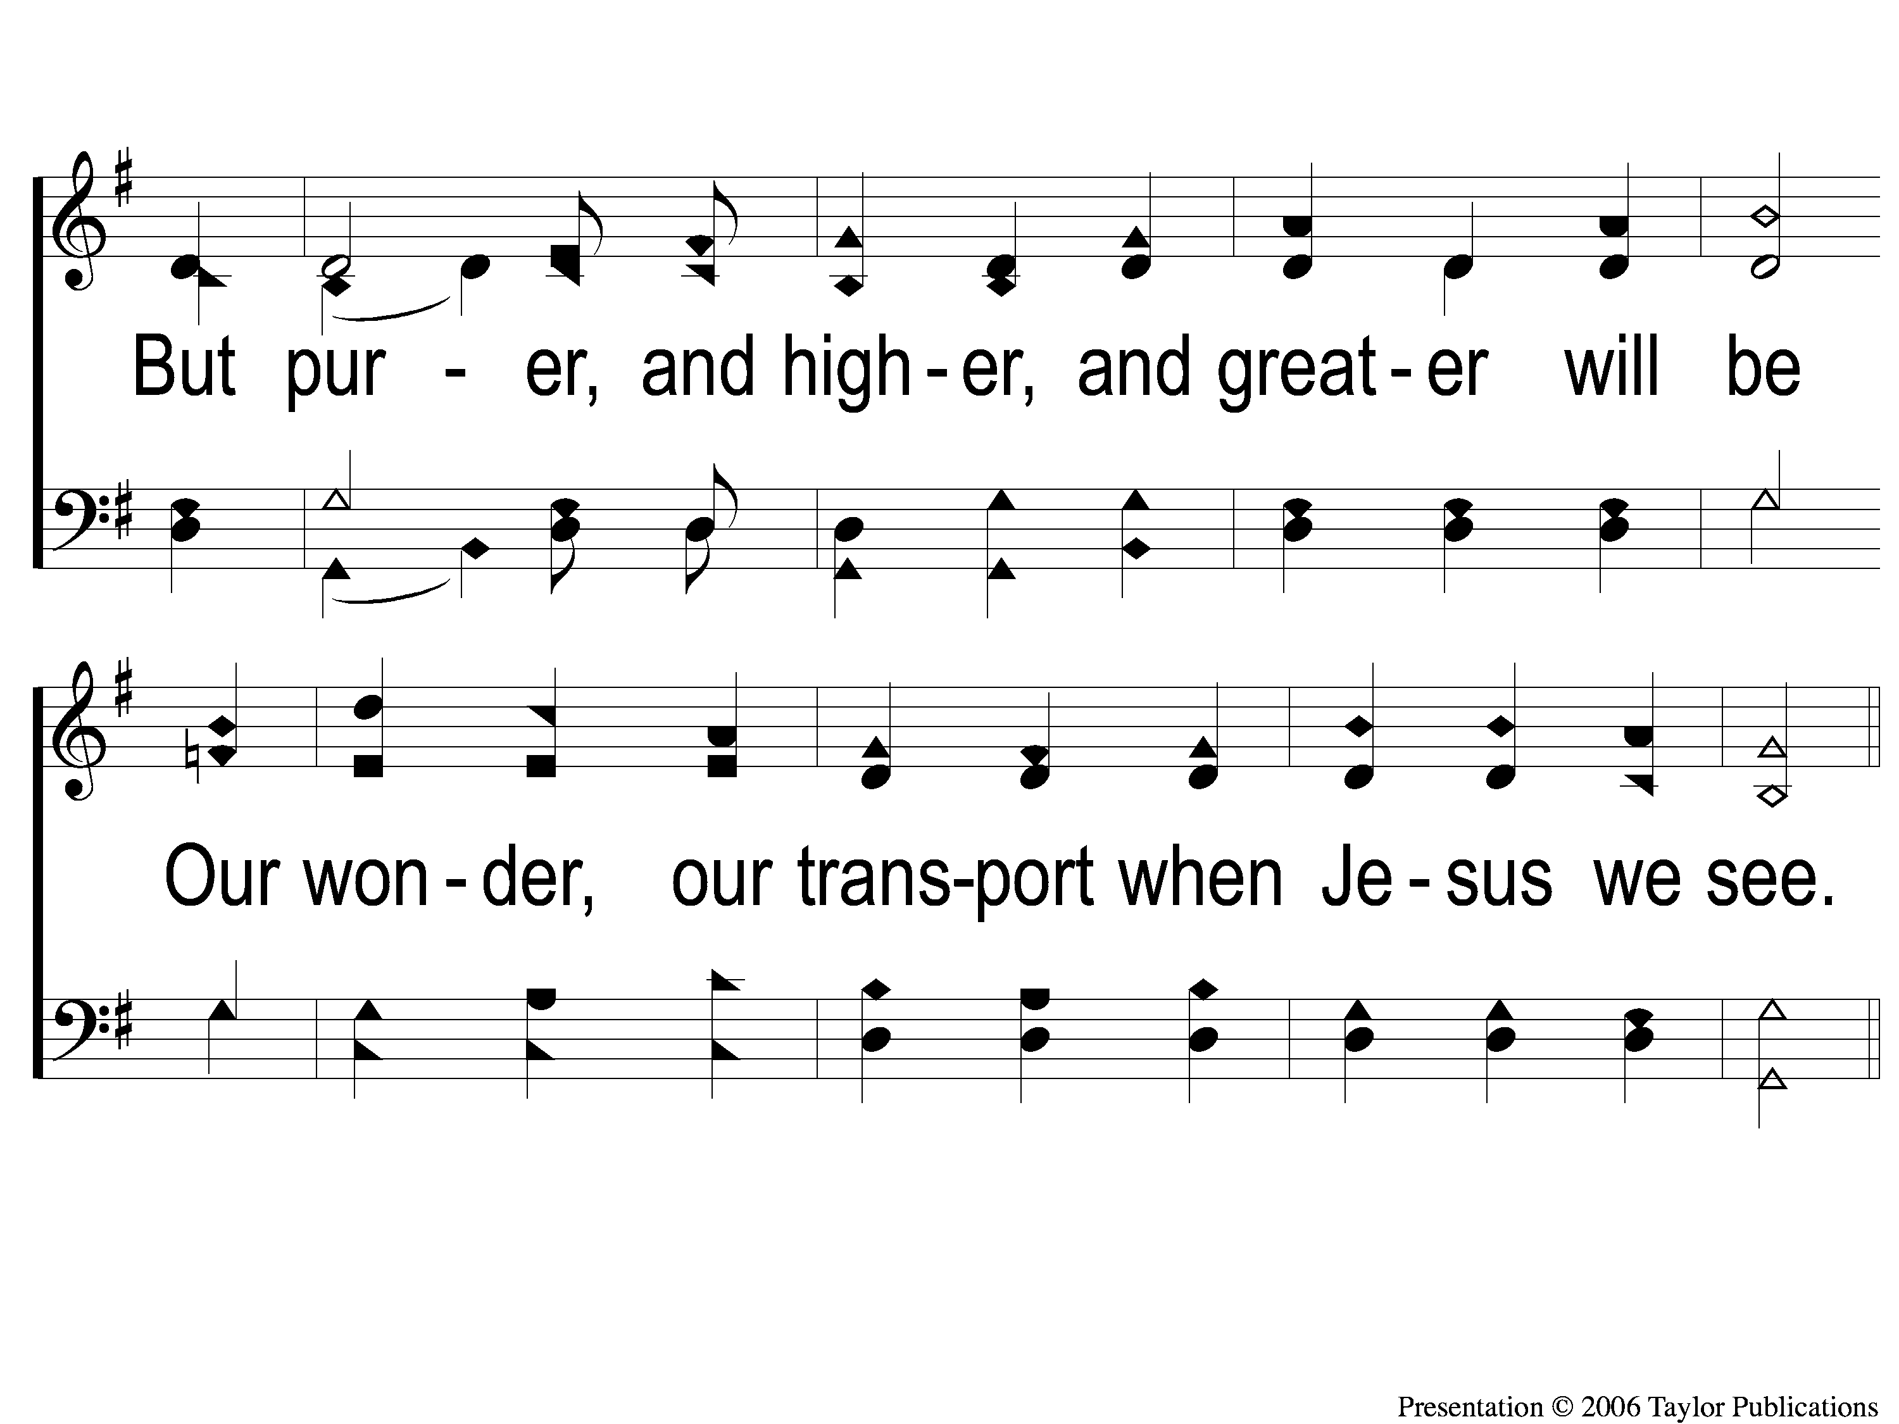
3-2 To God Be the Glory
To God Be the Glory
15

Slide 11
C-1 To God Be the Glory
To God Be the Glory
15

Slide 12
C-2 To God Be the Glory
To God Be the Glory
15

